Slide 1


Automatic Skull Segmentation from CT Scans
Darren Geng, Mousumi Roy, Mohit Khemchandani

Slide 2
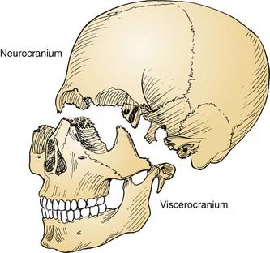
Background
Goal: Automate the segmentation of the skull out of CT scans of the head
In particular: the Neurocranium
Currently: Manually done, labor intensive
CT scans are big!
~512x512x512 : around 134 million pixels

Slide 3
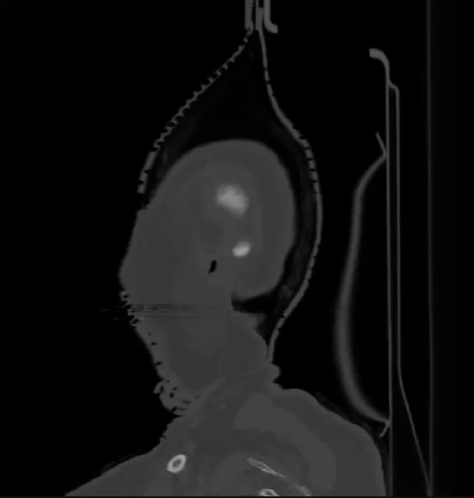
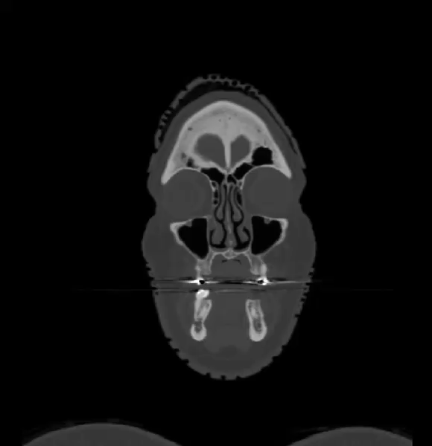
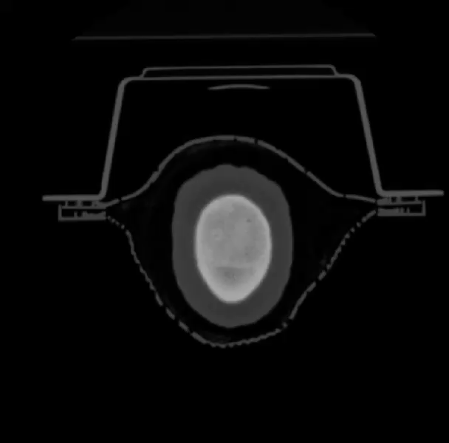
Sample CT Scan
Sagittal
Coronal
Axial

Slide 4
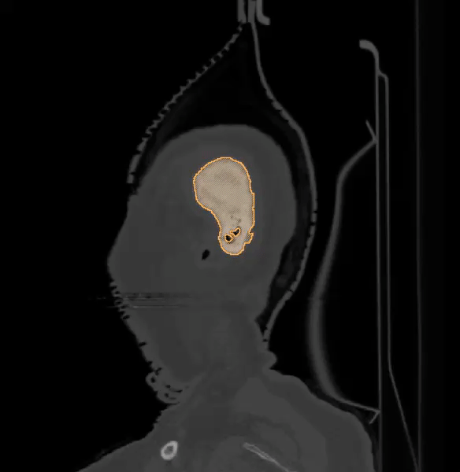
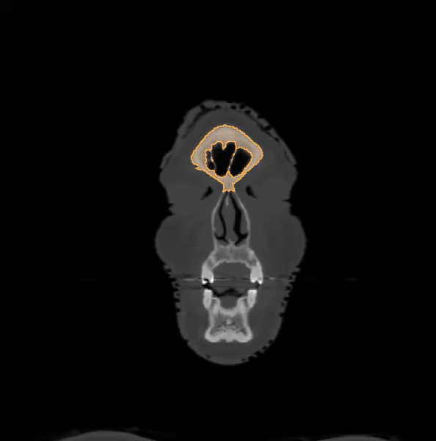
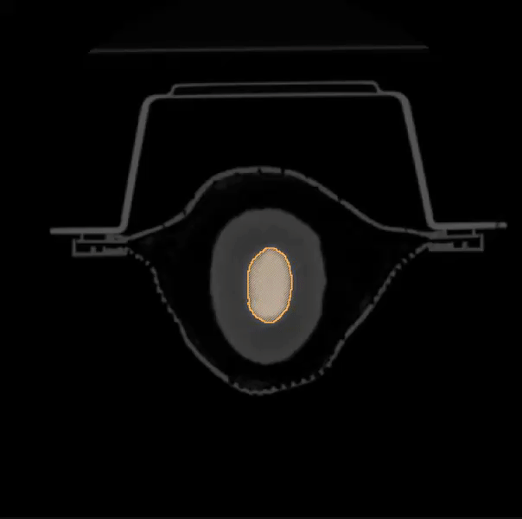
Sample Segmentation
Sagittal
Coronal
Axial
Hand Annotated in Seg3D2

Slide 5
Things to Consider
Not many CT scans to work with (~60)
ImageNet dataset: Hundreds of thousands of images, 500 per node (object)
Although, this turns out to actually not be an issue...
Again, scans are large!
~512x512x512, around 134 million pixels per scan

Slide 6

Neural Networks?
Regular fully connected neural networks do not scale well with images
Consider a 32x32x3 image (32 wide, 32 high, 3 color channels)
32*32*3 = 3072 weights needed
200*200*3 = 120,000 weights needed
512*512*512*3 = disaster

Slide 7
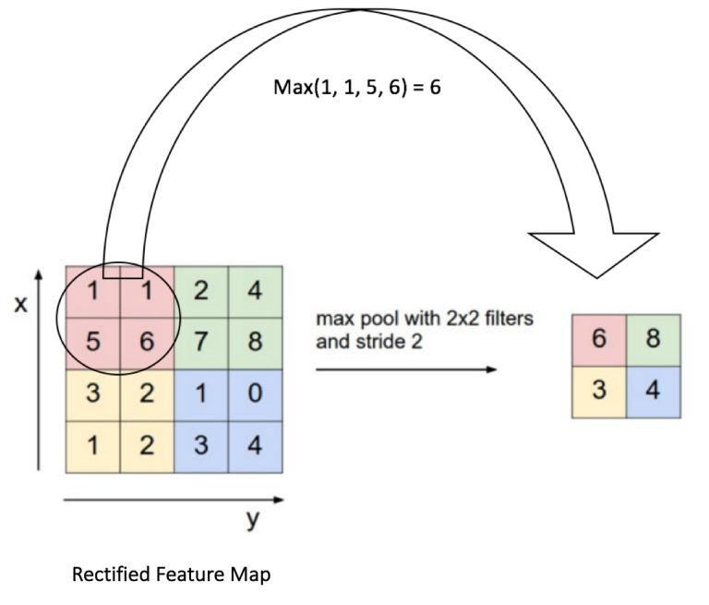


Convolutional Neural Networks
Solution: Take advantage of the fact we are working with images
No need for a fully connected network
Learn/extract filters (kernels), convolve the image to generate activation maps, downsample the image via pooling, repeat
Known as Convolutional Neural Networks (CNNs/ConvNets)
Convolution
Convolution Example
Pooling

Slide 8

CNNs (continued 1/2)
Very commonly used in analyzing visual imagery

Slide 9
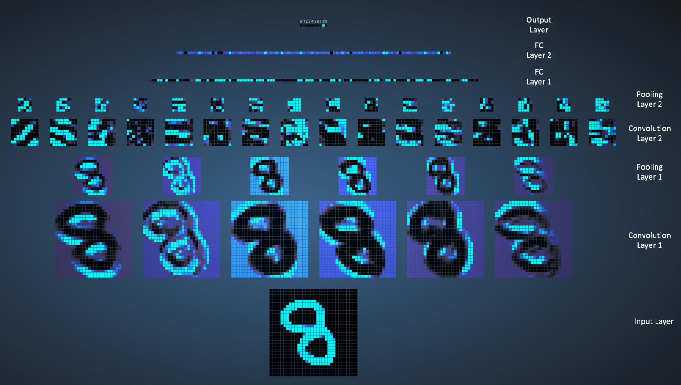
CNNs (continued 2/2)

Slide 10
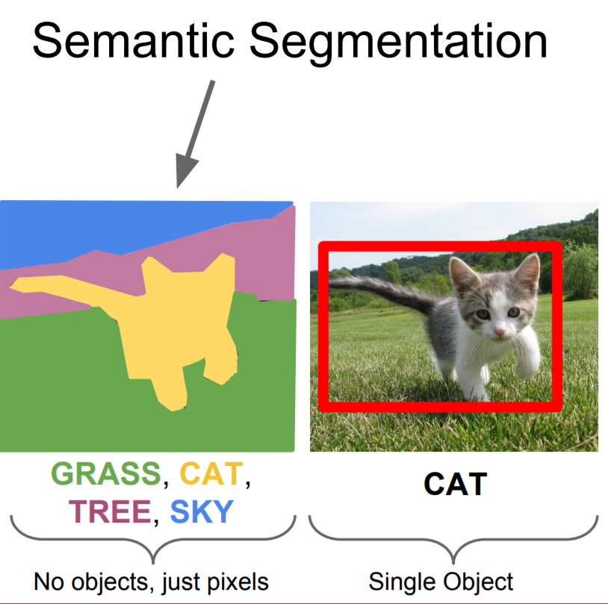
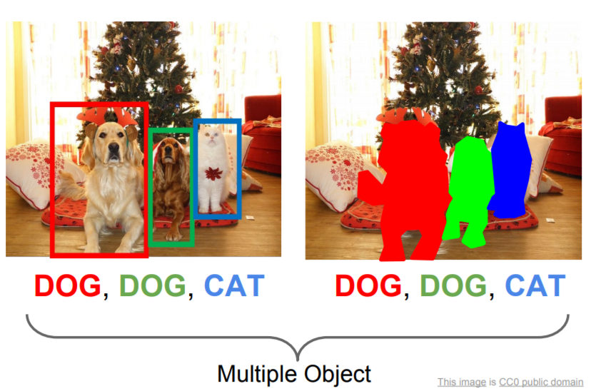
Problem with CNNs
CNNs primarily handle classification
Need:

Slide 11
Fully Convolutional Network
Remove the fully connected layer
Introduce upsampling
Now known as a Fully Convolutional Network
Pixel by pixel classification
Able to perform semantic segmentation

Slide 12
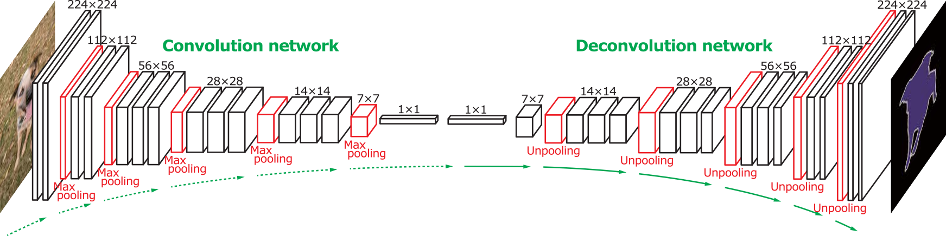


FCNs (continued)
Pooling vs. Unpooling
GIFs from:
https://github.com/vdumoulin/conv_arithmetic

Slide 13
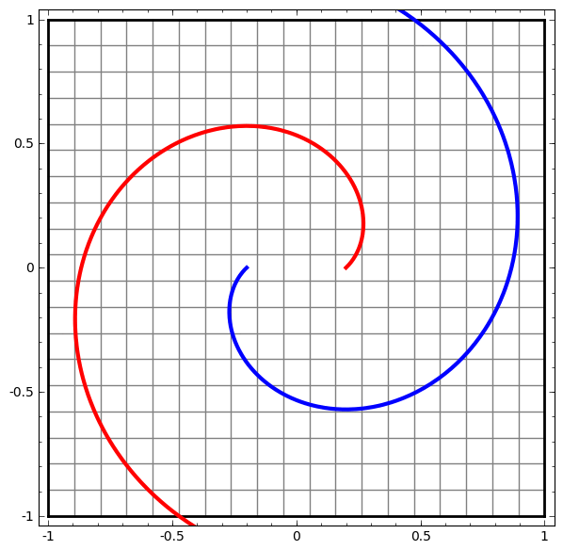
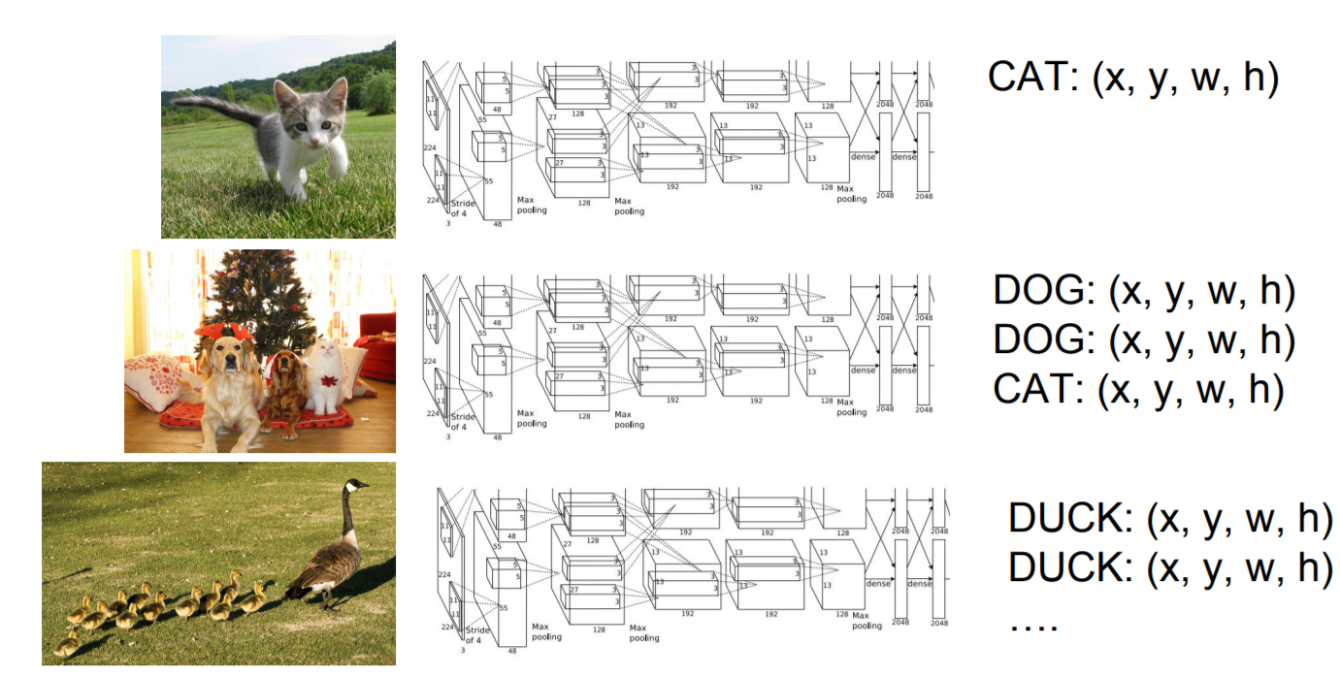
Closing notes on CNNs/FCNs
You can learn more at: http://cs231n.stanford.edu

Slide 14
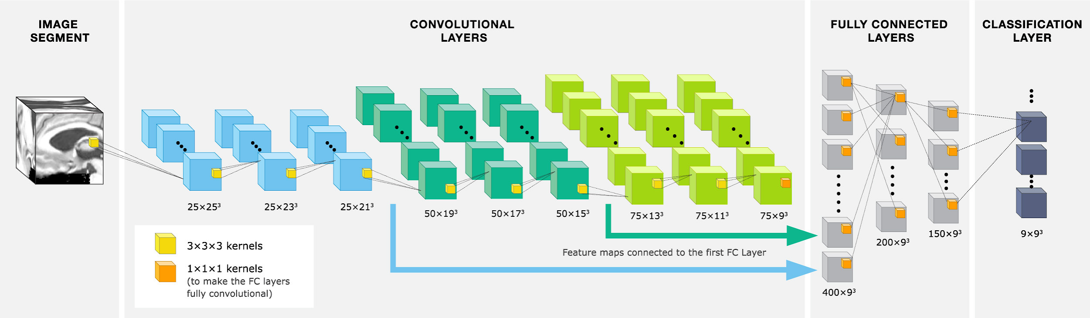
Architecture we used
Used an FCN (LiviaNET)
J.Dolz et al. December 2016: 3D fully convolutional networks for subcortical segmentation in MRI: A large-scale study

Slide 15
LiviaNET
Activation function: PReLU, Parametric Rectified Linear Unit (He et al., 2015)
Process subvolumes rather than the whole image (27x27x27 for training, 35x35x35 for testing)
State of the art (as of publication)
~2 days to fully train on 8 scans
https://github.com/josedolz/LiviaNET (Python 2.7, Theano)

Slide 16
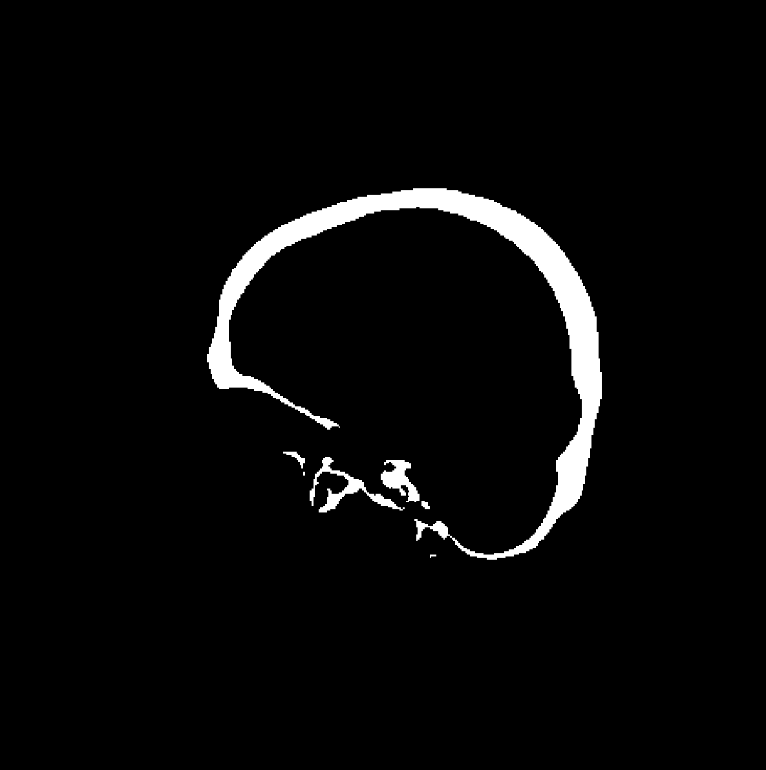
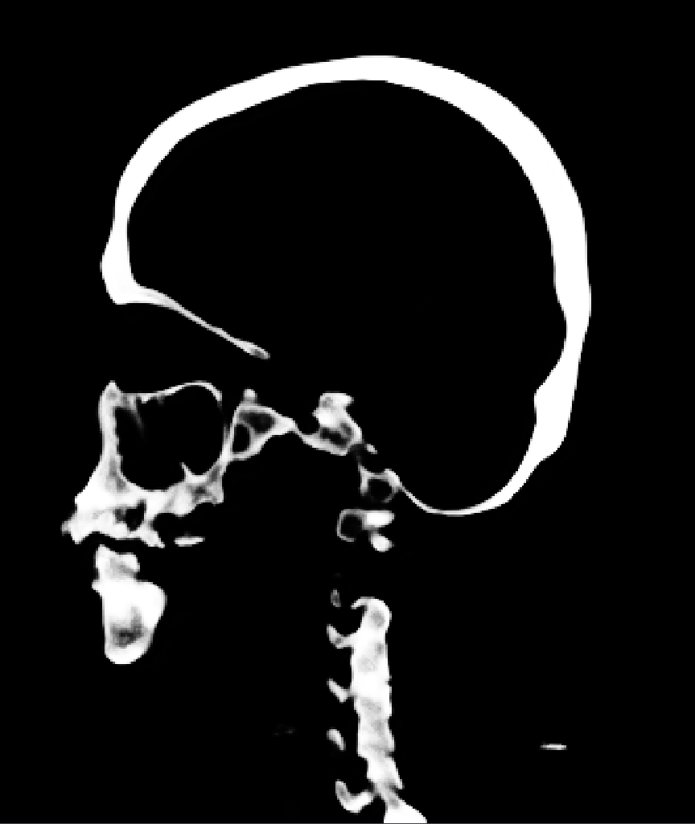
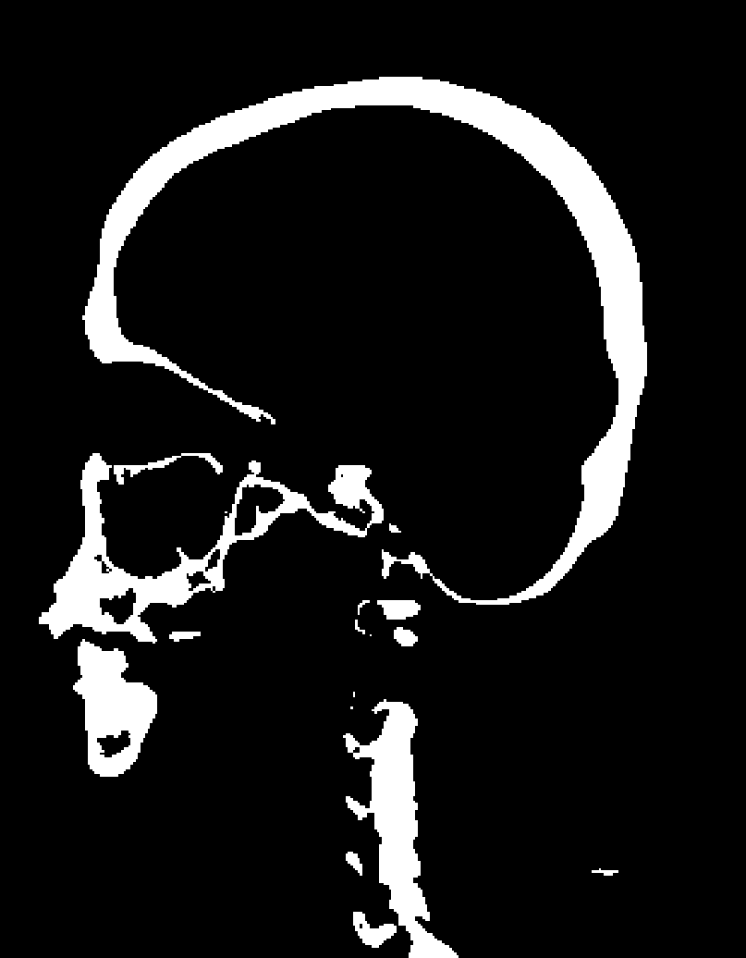
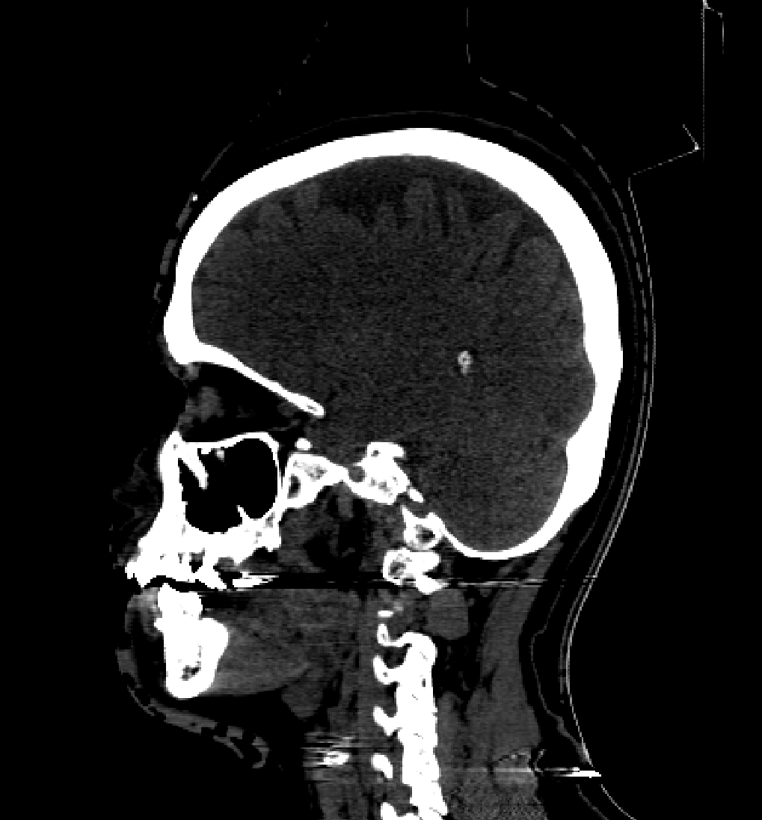
Results (⅓)
At first, not great.
Segmentation (DSC: 0.7969)
Probability Map
Ground
Truth
Scan

Slide 17
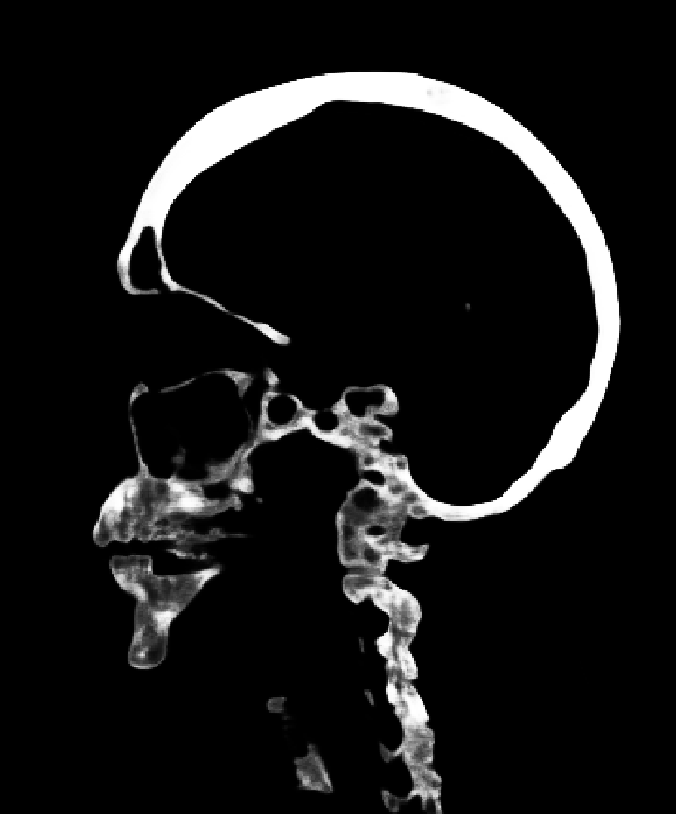
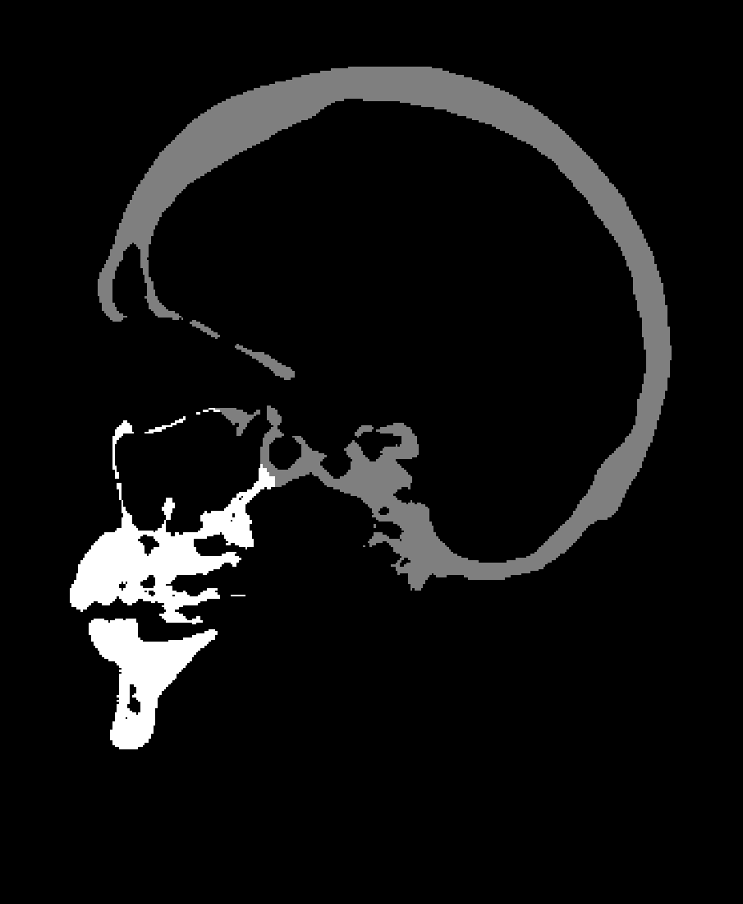
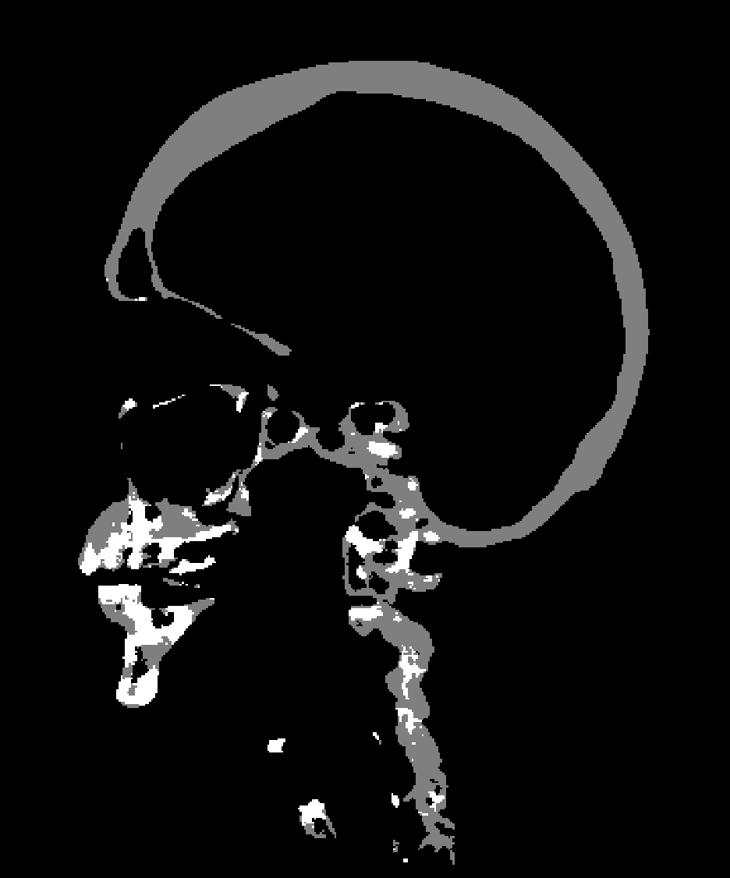
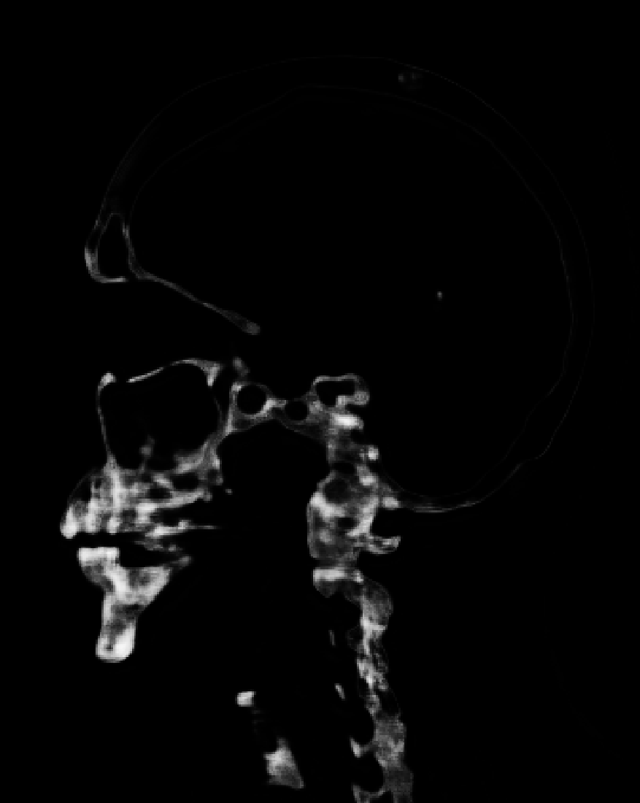
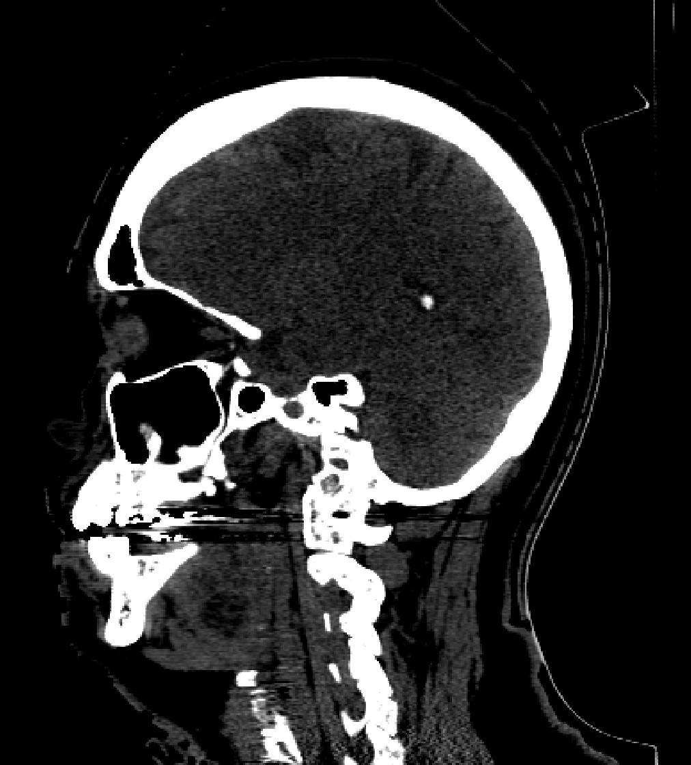
Results (⅔)
Segmentation DSC Scores: A = 0.8081, B = 0.4171
Prob. Map A
Ground Truth
Scan
Prob.
Map B

Slide 18
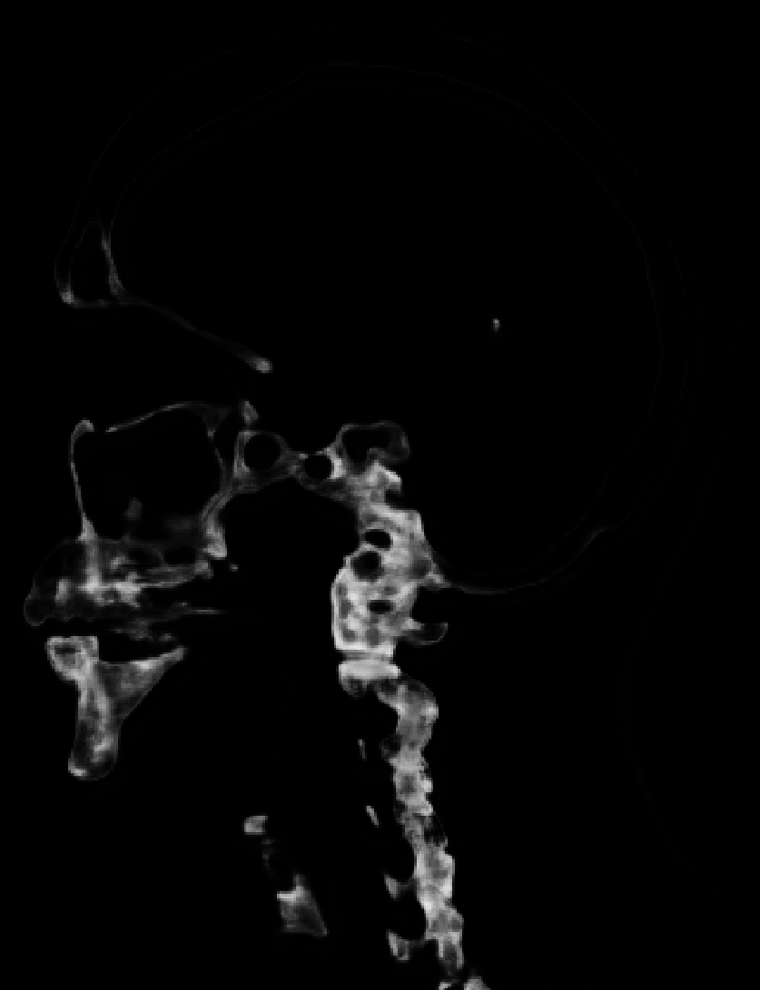
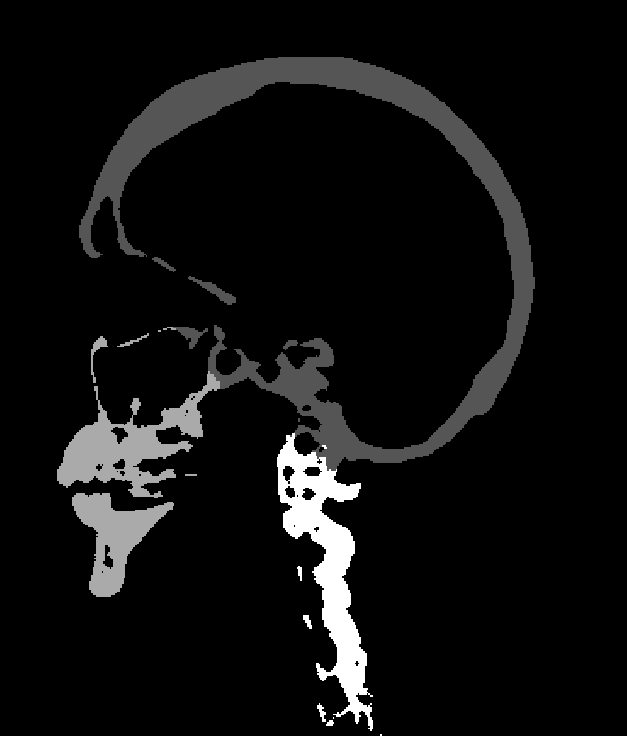
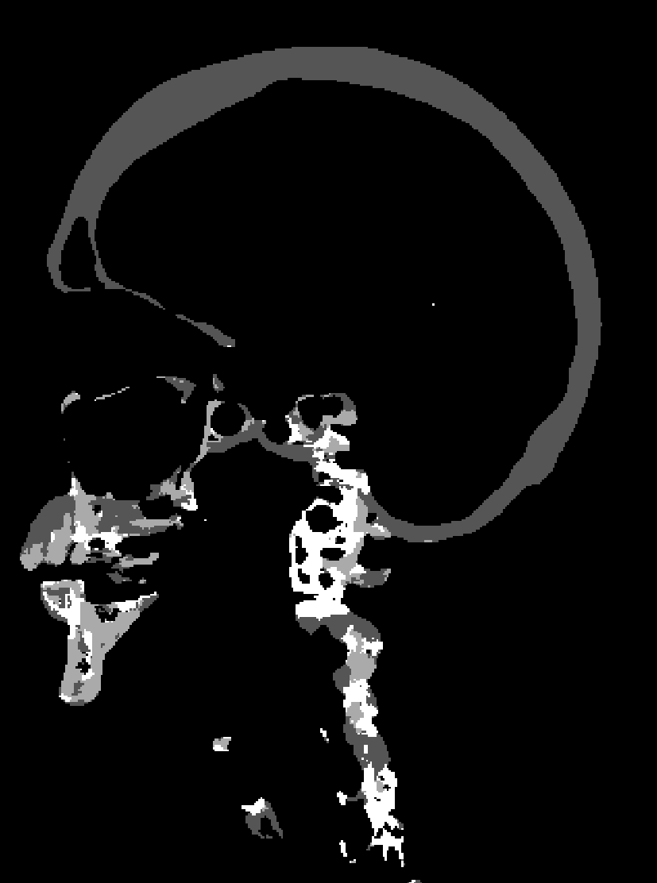
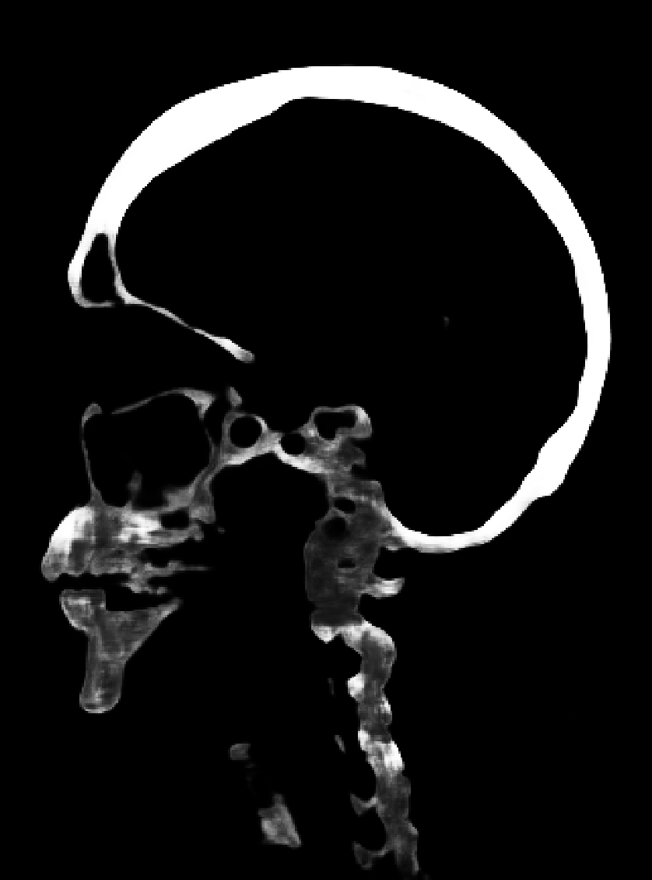
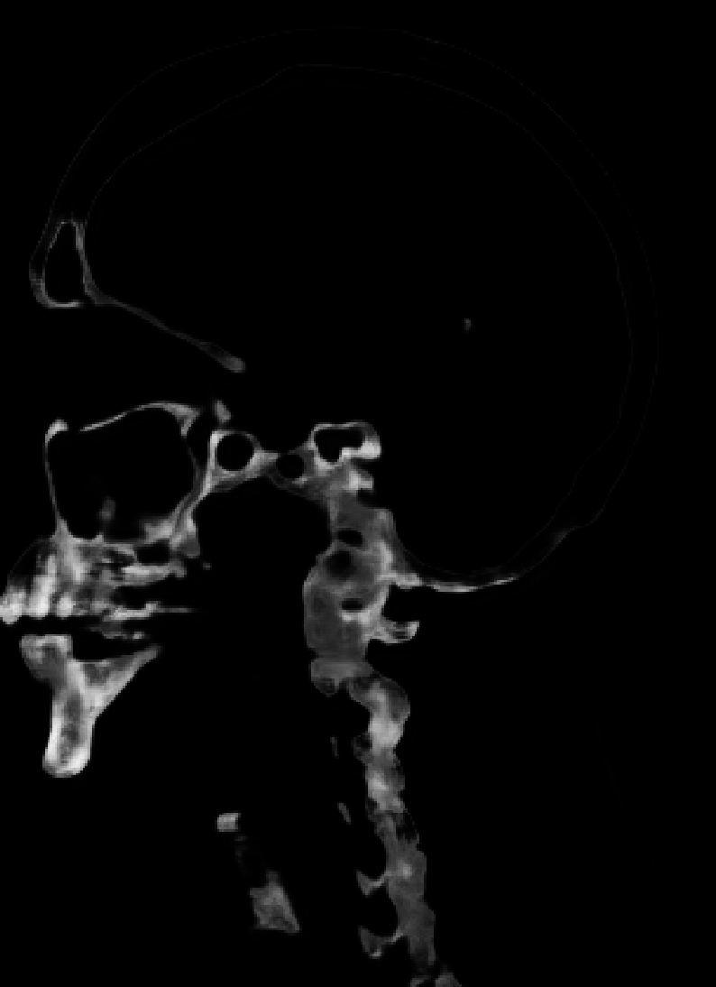
Results (3/3)
Currently Ongoing
Segmentation DSC: A: 0.8174, B: 0.4120, C: 0.4460
B
A
Ground Truth
Scan
C

Slide 19
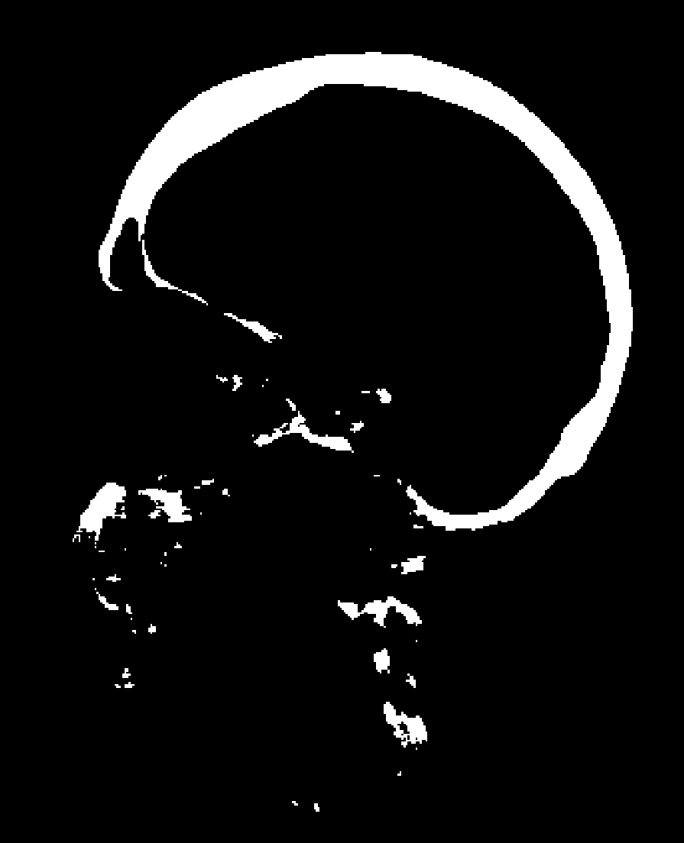

Final Steps
ProbMap A
Values > 0.94 (0 = black, 1 = white)
Largest connected component
Done in MATlab

Slide 20
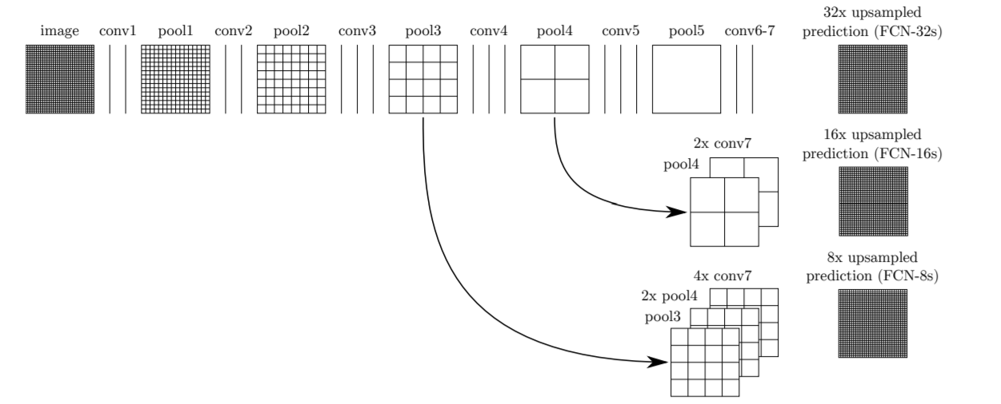
Other Approach(es)
Mohit re-implemented a pre-existing model in TensorFlow
Adam-Optimizer with a learning rate of 9e-4
Currently facing issues running on the GPU cluster
Long et al. 2014: Fully Convolutional Networks for Semantic Segmentation

Slide 21
Closing Thoughts/Remarks
Mentors: Dr. Jinkoo Kim, Pengyue Zhang
Excellent results
Can do better
Next Steps:
Wait for current FCN to finish training
Delete skull from CT scan with the segmentation
Why does the current network perform poorly by itself? (primarily with segmenting spine/viscerocranium)

